Slide 1
Integrating Technology into Math, Science and Social Studies
Alissa Carter
Advanced Academic Services/Instructional Technology Coordinator
alissa.carter@plainviewisd.org

Slide 3
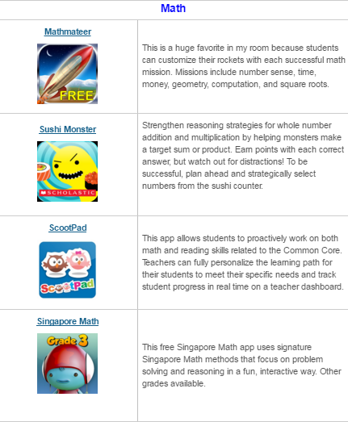

Slide 4
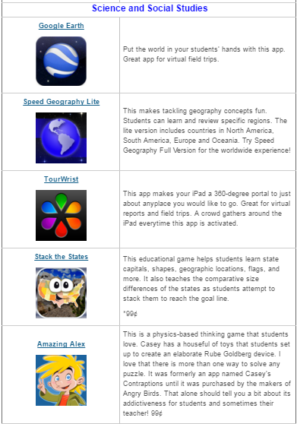

Slide 5
Medelia is a free app helping kids learn about the history of Mediterranean cities.
European Exploration is a free app letting kids to be a 15th Century ship captain who is responsible for building the ship, recruit the crew, and explore the world.
Eric and Bruce Travel to Britain is designed for preschool to kindergarten kids to learn the history of Britain. It is a self paced exploratory app for young children.
Ancient Rome by Britannica Kids is a very well designed app teaching kids about ancient Rome, including media rich material, games, and quizzes.
Timeline Eons is a very uniquely designed app. All major historical events are organized on the timeline, kids can zoom in and out the timeline to learn history during certain time period.
Timeline World War 2 with Robert MacNeil is another timeline app. Users can zoom in and out of the timeline of the entire war, go through over 2000 events, with information on key personalities, battles, locations.
Timeline World War 1 with Robert MacNeil is a similar app to the last one, but is for World War I.

Slide 6
Today in History is the best way to get key facts about iconic global events and fun facts from across the centuries.
The Oregon Trail: many people have played the computer version of the game. Now it is also available as apps. Kids role play as historical pioneers traveling west in the 1800s.
President vs Aliens is a fun game helping kids learn about US presidents.
JFK Challenge is a free app from The John F. Kennedy Presidential Library and Museum, for kids to learn the history, particularly the two initiatives by JFK – The Peace Corps and The Space Program.
US Presidents by Britannica: includes detailed profiles of all the US presidents, such as presidential portrait, first lady, birthday and fun facts.
Photogrammar is a free photo archive of World War 2 pictures of American life. You can search by year and location that the photo was taken. You can also search by more than 15 categories, such as war, work, building. Each category has many sub-categories.
Faking It is a free app from The Metropolitan Museum of Art. Kids can learn about history through the famous edited photos in history

Slide 7
Top of our list is Questionaut – an interactive game that is a little steam punk and a whole lot of fun. Break this out to get kids excited about test prep and give them an opportunity to brush up on all topics (and not just science)! The puzzle solving and use of the scientific method throughout makes it SO worthwhile… and don’t forget to turn up the volume – the music is great!
Edheads is an engaging science inquiry site. Students can pick from virtual surgeries, machine building, car crash investigations and more. It’s very innovative and even has accompanying handouts for educators to use along with the different online activities so students can complete assignments as they play and learn.
Wonderville is, well, wonderful! It’s a mixture of movies and interactive lessons that are quirky, educational, and fun for all ages. They tackle a variety of science topics and their lessons are thorough enough to incorporate into your day as a bell ringer, station, or as closure!
Launchball! Launch ball is the perfect way to get students to tinker with trial and error while they unassumingly learn about Newton’s laws of motion and simple machines. The object of the game is easy: get the ball from point “a” to point “b” – then discover what physics concepts you covered in the end. This is a perfect way to start your year as you review the scientific method or review physics concepts before testing.

Slide 8
Get Clobbered We love this site! We use it during our review of Lab Safety. Choose a character and send them along the assembly line where they are assigned a scientist job. Have students come up to your interactive white board to place the different safety equipment on their bodies to help them survive their harsh work environment. The character is then sent through a work simulation where students discover if their character is unharmed or ends up dizzy with disease.
Vector Park’s Levers is a relaxing physical science site that is all about balance. Students get new materials and levers each time they create a balanced structure. It’s perfect for introducing or reviewing the scientific method and is great for any down time you may have in class. You can get the entire class involved as they share ideas on how to balance the items provided.
Who Wants to Live a Million Years – hands down a favorite for our kids. We use it during our study of Evolution. To start off the game, Darwin discusses the meaning of Natural Selection and survival of the fittest. Then, students pick out their creatures with the idea that diversity = increased chance of survival. Will the evolving population survive a changing and sometimes cruel environment? You will see!
Arnold’s Lost all his Organs! It’s silly, it’s Arnold Schwarzeneggery, and it’s a little elementary, but it’s a great intro to Human Body Systems. Students must give Arnold the appropriate organs for each system. They have unlimited chances, and if a child gets stumped, it’s great to have the help of their classmates to find the right answer!
Digestion Story is a visual journey through the digestive system. Students will learn how various foods like proteins, fats, and simple and complex sugars are broken down physically and chemically. It’s an entertaining and comical trip from beginning to end…
DNA Learning Center is our go-to for amazing videos and animations for cell biology and genetics. This site has mesmerizing microscopic animated pieces about transcription and translation, unzipping DNA, 3-d brain model exploration and more!

Slide 9
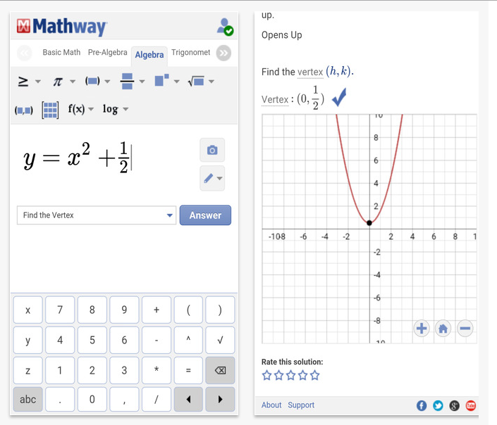
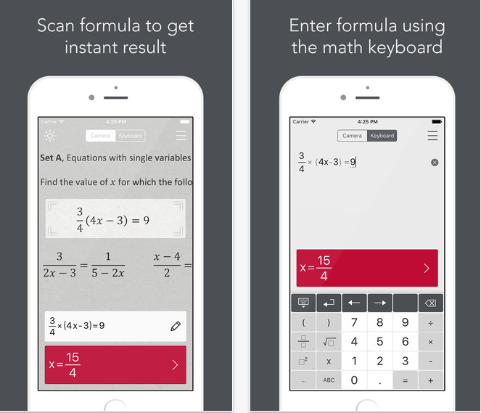
Photomath - Camera Calculator
By Photomath, Inc.
View More by This Developer
Open iTunes to buy and download apps.
Mathway - Math Problem Solver
By Mathway, LLC
View More by This Developer
Open iTunes to buy and download apps.

Slide 10
https://www.graphite.org/top-picks/awesome-algebra-apps-and-websites

Slide 11
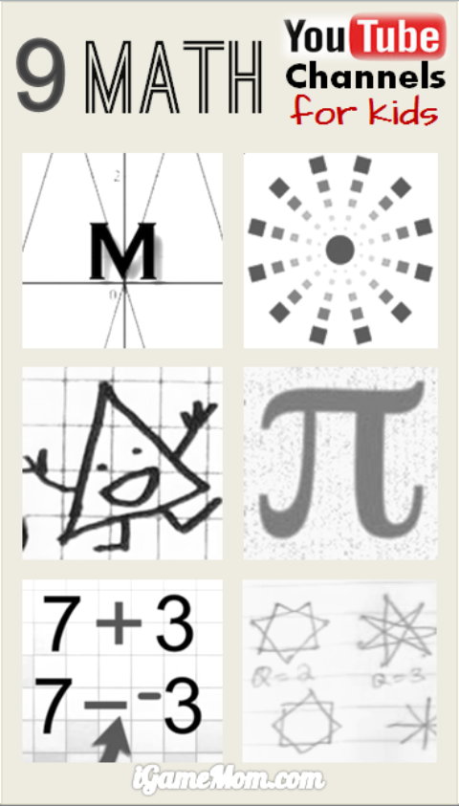
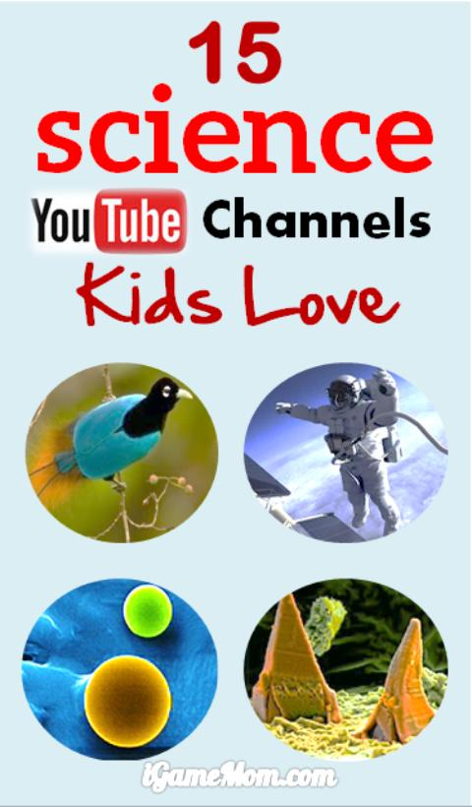

Slide 12
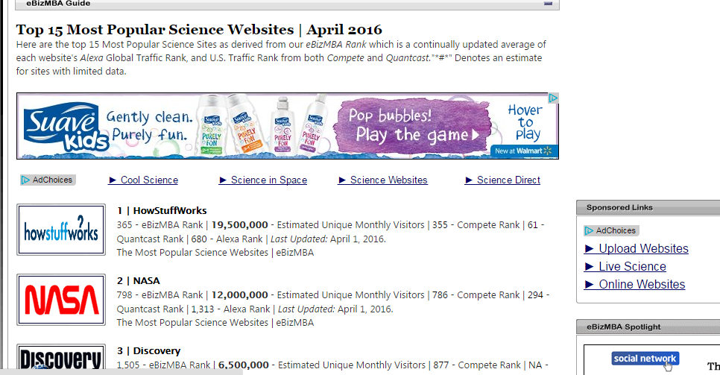
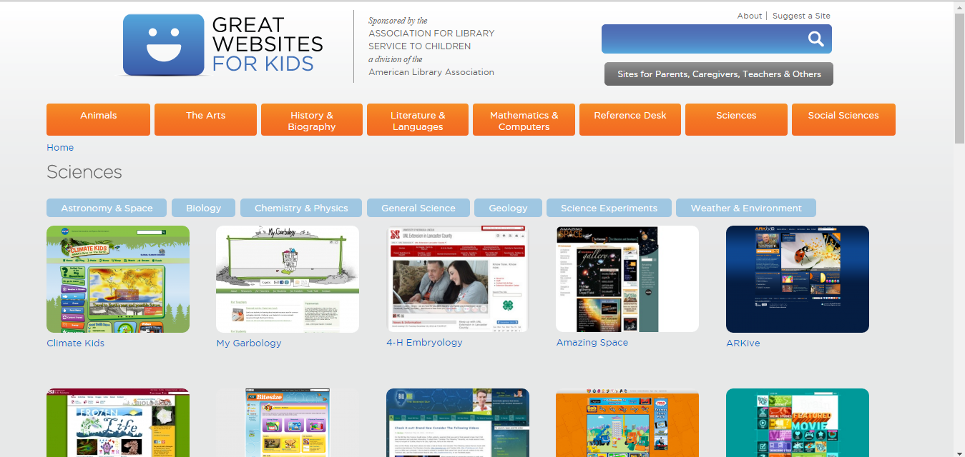
Science Websites

